Slide 1
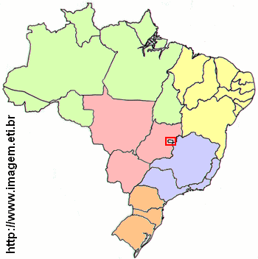
3%
18%
6%
45%
28%

