Slide 1
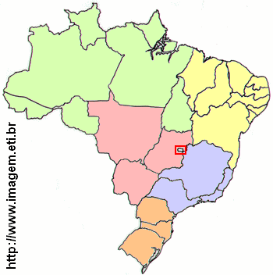
6%
23%
8%
36%
27%

