Slide 1
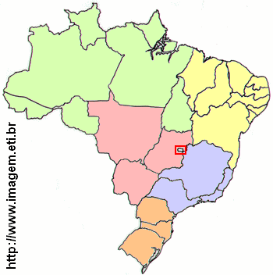
15-> 7%
51 -> 24%
17 -> 8%
69 - 33%
60 -> 28%

